Slide 1
ORGANISATIONAL
BEHAVIOUR
CHAPTER-1
A PRELUDE TO
ORGANISATIONAL BEHAVIOUR

Slide 2
LEARNING OBJECTIVES
The nature of organisations, reasons why they exist, and organisational effectiveness
The nature of organisational behaviour, its foundations, its importance, and limitations
Human resource approach, contingency approach, productivity approach, systems approach, and interactionalism approach to the study of organisational behaviour

Slide 3
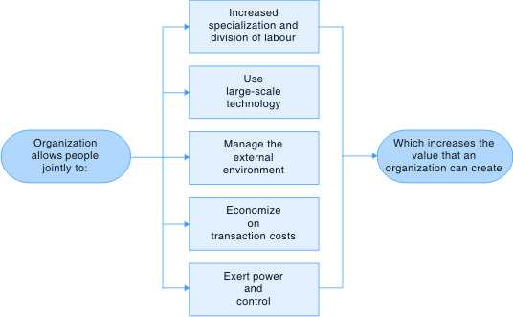
Five Reasons Why Organisations Exist

Slide 4
Best Employers
Ranking is done every year. In a study during 2006-07, the best employers were:
Rank Name of the Year of Global No. of
Company/Group Incorporation Revenue Employees
1 A.V.Birla Group 1949 $ 12 billion 88,000
2 Satyam Computer Services 1987 Rs. 4,793 crores 40,000
3 J.W.Marriott 1999 $ 100 million (India) 2,100 (India)
4 Eureka Forbes 1982 Rs. 850 crores 8,064
5 Cisco India 1995 $ 30 billion 2,200 (India)
6 Godrej Products 2001 Rs. 657 crores 1,190
7 Agilent Tech 1999 $ 4.97 billion 1,250 (India)
8 Scope International 2000 $ 135 million 4,600 (India)
9 TCS 1968 Rs. 11,214 crores 83,500
10 Kotak Mahindra Bank 2003 Rs. 937 crores 5,293

Slide 5
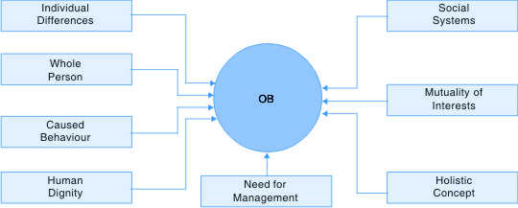
Foundations of OB

Slide 6
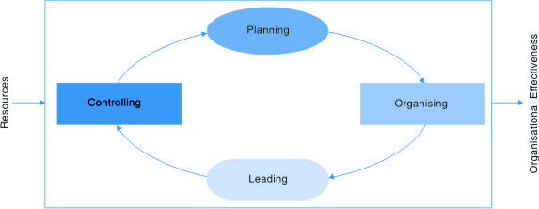
Functions of Management

Slide 7
Importance of OB
Road map to our lives in organisations
Helps us understand and predict organisational life
Influences events in organisations
Helps understand self and others better
Helps a manager get things done better
Helps maintain cordial relations
Highly useful in the field of marketing
Helps in career planning and development
Helps sustain the temp of economic growth

Slide 8
Limitations of OB
Knowledge about OB does not help an individual manage personal life better
Dualities of OB are baffling
Has become a fad with managers
Is selfish and exploitative
Managers expect quick-fix solutions-not possible
Principles and practices may not work in the events of declining fortunes
Cannot eliminate totally conflict and frustration

Slide 9
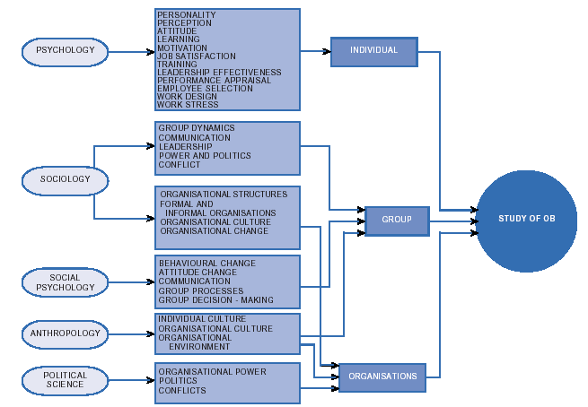
Major disciplines and their contributions to ob

Slide 10
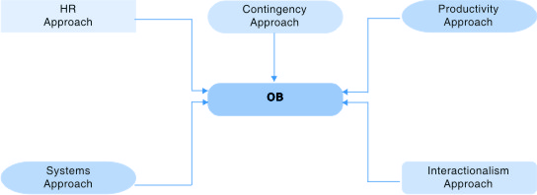
Approaches to the Study of ob

Slide 11
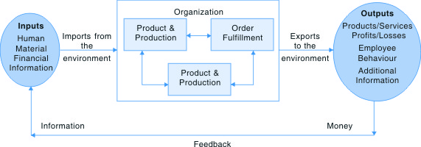
Systems Appraoch to Organizations

Slide 12
Summary
        Organisations have no parallels in so far as affecting daily life is concerned. They are created by individuals alone or in groups. On being formed, organisations facilitate division of labour, manage large-scale technology, manage the external environment, minimize transaction costs, and exert power and control.
        Organisational behaviour is highly useful in ensuring organisational effectiveness. Simply told, OB is the study of human behaviour in organisational settings.
        OB is built on strong fundamentals which are: interpersonal differences, whole person concept, caused behaviour, human dignity, social systems, mutuality of interests, and holistic concept.
        OB has its strengths and weaknesses. Among the strengths are: OB helps in shaping our organisational lives; it helps an individual understand his/her self and others better; it builds cordial industrial relations; and it is highly useful in the field of marketing.
        Critics point out that OB is selfish and exploitative, and that it does not remove conflict and friction between individuals-it only minimizes them.
        OB is an interdisciplinary subject. It has enriched itself by drawing principles and concepts from psychology, sociology, anthropology, social psychology, political science, engineering, and even medicine.
        Under the umbrella of OB, the topics covered are many and varied. Broadly, OB covers intra-individual behaviour, inter-personal behaviour, and behaviour of the organizations.
        Several contextual perspectives have increasingly influenced OB. They are-the human resource approach, the contingency approach, the productivity approach, the systems approach, and the interactionalism approach. All these approaches together, help us understand OB better.

